Slide 1

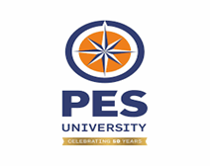


CCBD & CDSAML center
Summer Internship, June–July, 2025
REVIEW 1
SceneCraft: Intelligent Object Placement and Seamless Scene Integration
SHREYA SADALGEKAR: PES1UG22AM153
UJWALA SHETTY: PES1UG22AM178
BINDU S: PES1UG23CS840
GUIDE: PROF. SINDHU R PAI

Slide 2
PROBLEM STATEMENT
Creating photorealistic composite images by inserting or replacing objects in indoor scenes by understanding scene context, geometry, and visual coherence.
Traditional image editing methods often result in unrealistic placements, visible seams, or inconsistent lighting, making the edited image appear artificial. The objective of this project is to develop an end-to-end pipeline that intelligently places objects in a scene, guided by semantic and geometric analysis, and seamlessly integrates them using advanced inpainting techniques. By leveraging state-of-the-art computer vision models for scene classification, segmentation, depth estimation, object detection, and generative inpainting, the pipeline aims to produce natural, contextually appropriate composites that align with the scene’s layout and lighting, enabling applications in interior design, augmented reality, and content creation.

Slide 3
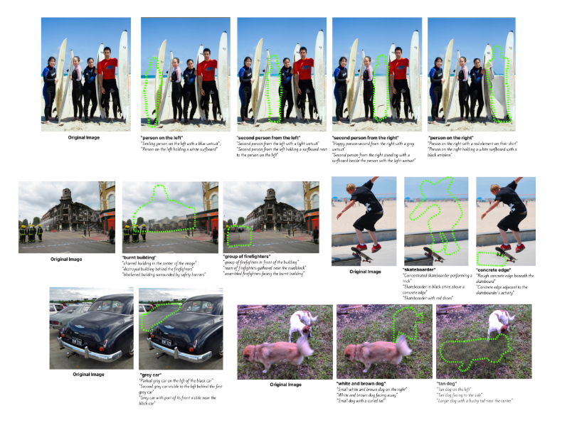
LITERATURE REVIEW
EraseDraw (CVPR 2024 – Columbia University)
Abstract
"Creative processes such as painting often involve constructing different components one by one. Prior works struggle with global edits or unrealistic object insertions. We find that state‑of‑the‑art models excel at object removal, not insertion. By inverting removal, we generate high‑quality training pairs where objects are erased with realistic context. This scalable pipeline enables training a text‑conditioned diffusion model for object insertion. Our model achieves state‑of‑the‑art, scene‑aware, and realistic insertions—both in single–step and iterative scenarios."
Method
Erase → label → train diffusion; supports iterative composition.
Autonomous Data Generation
Use segmentation + captioning + inpainting models to remove objects from real images.
Label erased regions with language metadata (object type, position).
Text‑conditioned Diffusion Insertion
Train a diffusion model using these synthetic “inserted” images.
Model learns spatial and contextual consistency.
Iterative Composition
Supports step-by-step insertion: model + CLIP-guided beam search to build complex scenes interactively.
Datasets
Custom EraseDraw Dataset (~15 GB)

Slide 4
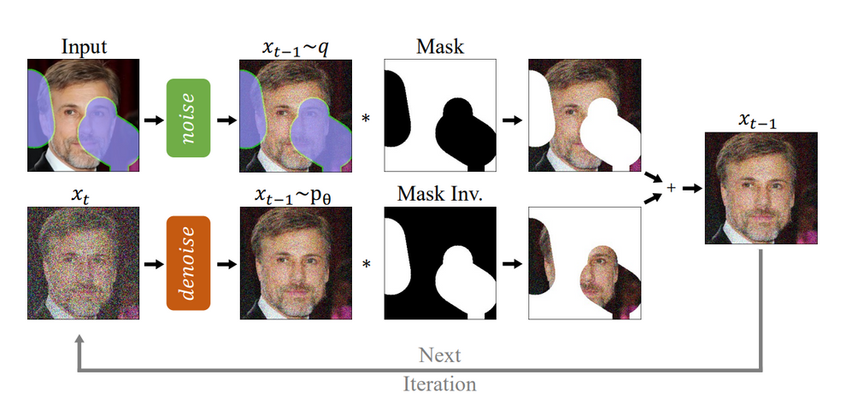
Repaint (Lugmayr et al., 2022)
Abstract
RePaint introduces a novel approach for free-form image inpainting using pretrained Denoising Diffusion Probabilistic Models (DDPMs). By conditioning an unconditional DDPM during inference, RePaint fills arbitrary missing regions without retraining, achieving high-quality, semantically coherent, and diverse results across datasets like CelebA-HQ, ImageNet, and Places2.
Method
Datasets
RePaint adapts a pretrained unconditional DDPM for inpainting by conditioning the denoising process. Given an image and a binary mask (white for missing regions, black for known), it:
Initializes with known pixels and noise in the masked region.
Runs T denoising steps (e.g., 1000), using the DDPM to refine the image.
At each step, retains known pixels and updates the masked region with DDPM-generated content.
Outputs a seamless image blending known and generated regions. The process leverages a U-Net-based DDPM trained on datasets like CelebA-HQ, with no modifications to the network.
CelebA-HQ (faces)
ImageNet (objects
Places2 (scenes)

Slide 5
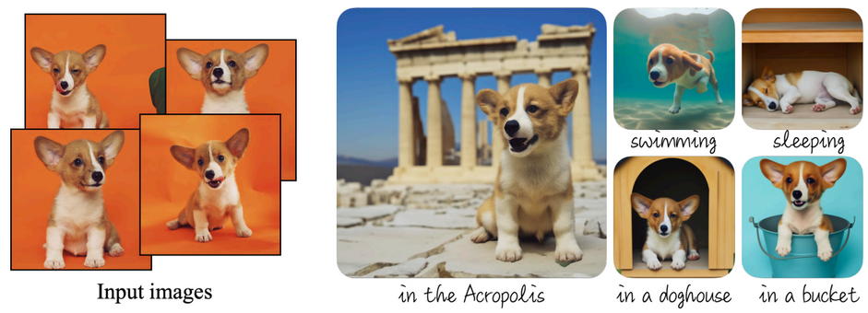
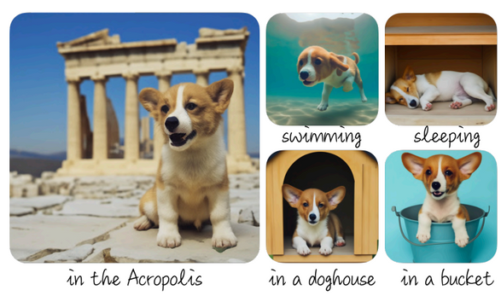
Dream Booth: Fine Tuning Text-to-Image Diffusion Models for Subject-Driven Generation (Nataniel Ruiz et al., 2022)
Abstract
DreamBooth enables personalized text-to-image diffusion models to generate photorealistic images of a specific subject in diverse contexts using just 3–5 reference images. It fine-tunes the model with a unique identifier and a novel prior preservation loss to maintain general knowledge while embedding subject details.
Method
Fine-Tuning: Updates the entire diffusion model (e.g., Stable Diffusion) with 3–5 subject-specific images and a unique identifier (e.g., “[V]”).
Prior Preservation Loss: Balances subject-specific learning with class-general samples to retain model’s broader synthesis capabilities.
Text Prompts: Pairs images with prompts like “[V] dog” to guide context-driven generation.
Output Generation: Produces novel images of the subject in varied poses, scenes, or styles based on user prompts.
Datasets
DreamBooth Dataset

Slide 6
Individual Contribution
1. Scene Classification – Bindu S
2. Semantic & Panoptic Segmentation - Ujwala Shetty
3. Depth Estimation – Shreya Sadalgekar
4. Object Detection & Removal and showing the placeable region – Bindu S
5. User Interaction for Placement, select a chair to replace- Shreya Sadalgekar
6. Object Segmentation (SAM) - Ujwala Shetty
7. Depth-Aware Scaling & Placement - Ujwala Shetty
8. Visualization - Shreya Sadalgekar

Slide 7
Pipeline Flow:
Scene image → Scene classification → Segmentation & placeable mask → Depth estimation → (Optional) object removal → User selects placement → Chair segmented & scaled → Chair composited onto scene.

Slide 8
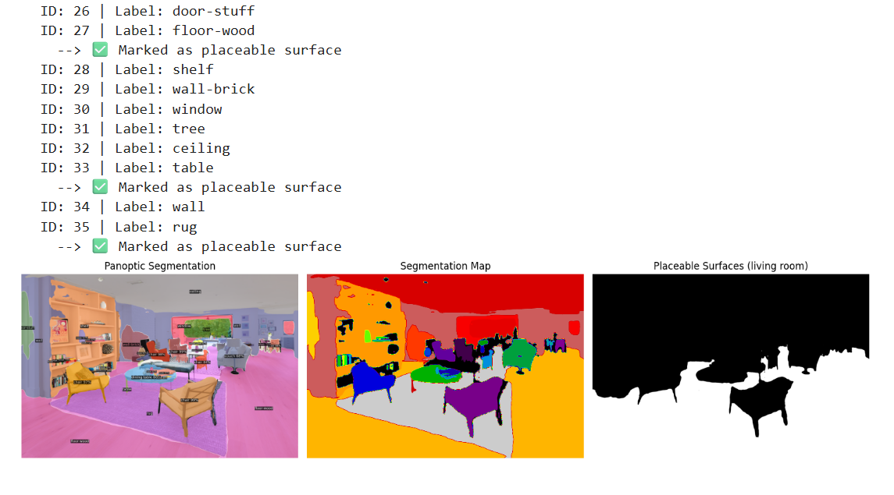
DEMO: Panoptic Segmentation

Slide 9
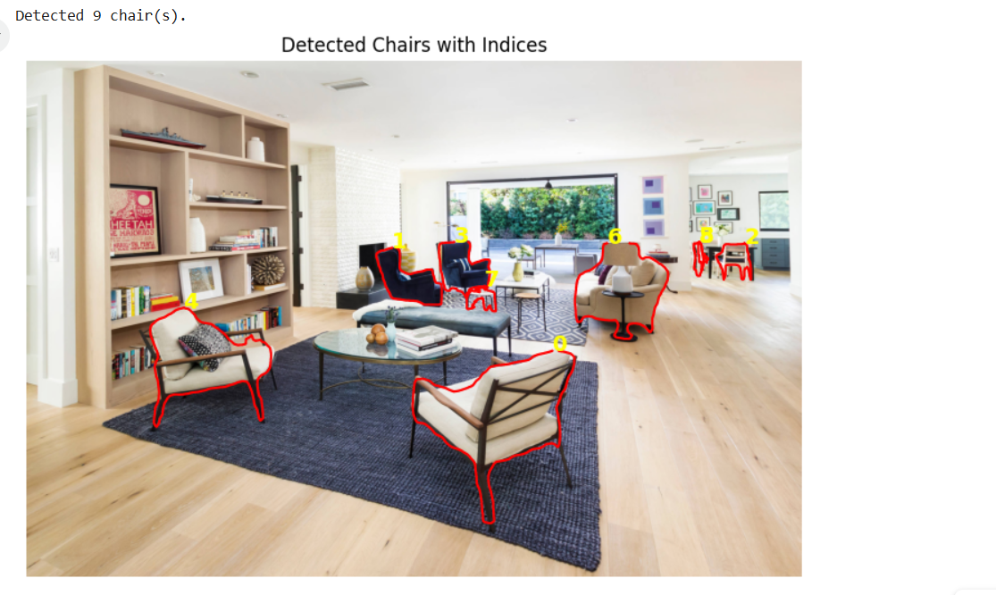
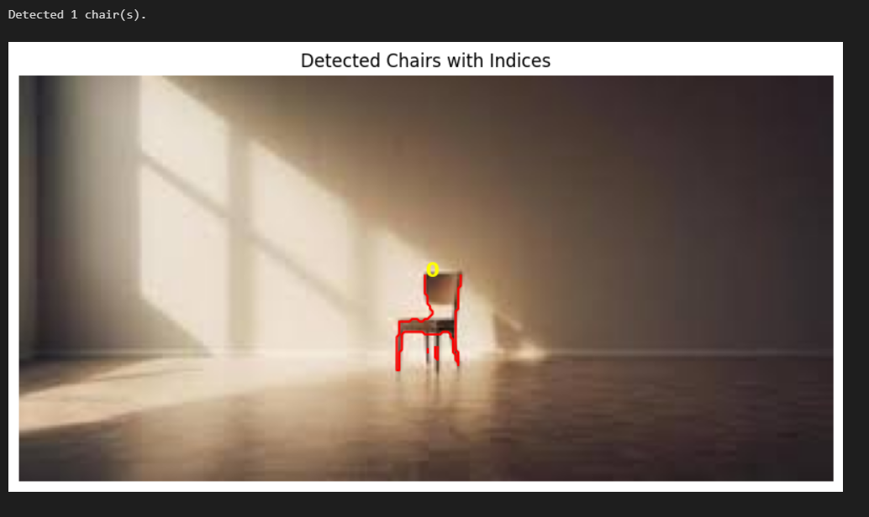
DEMO: Object Detection

Slide 10
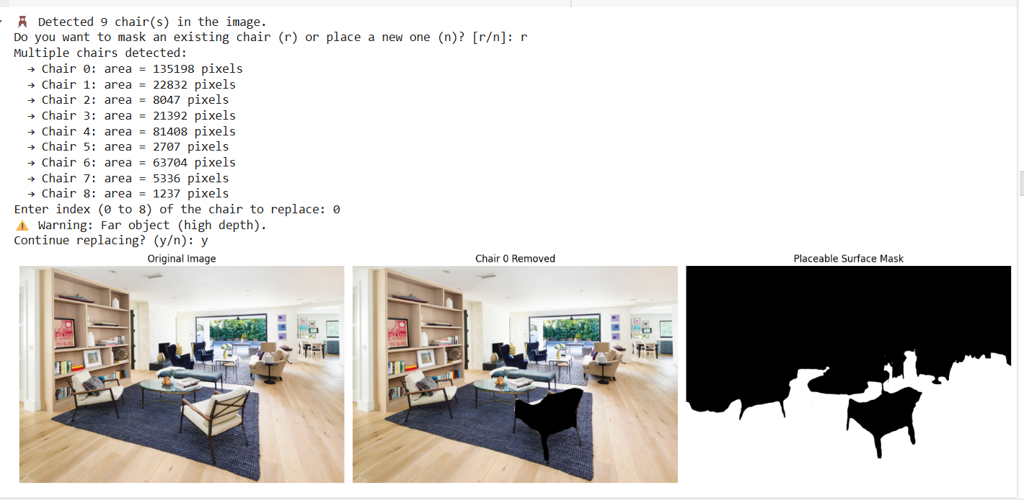
DEMO:

Slide 11
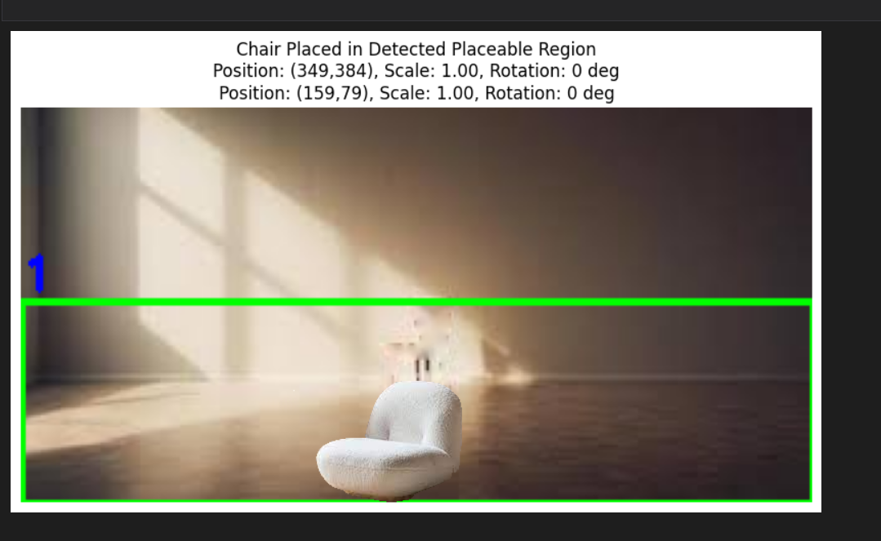
DEMO:- Object Placement

Slide 12
THANK YOU

